Slide 1
Digital Image Processing
Lecture 11: Image Restoration III (Degraded Image Restoration)

Slide 2
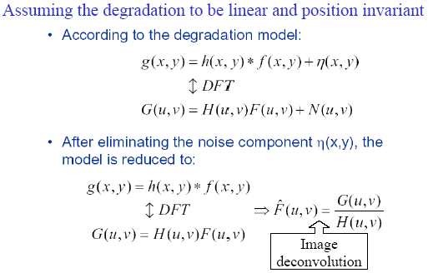
Degradation Model for Image

Slide 3
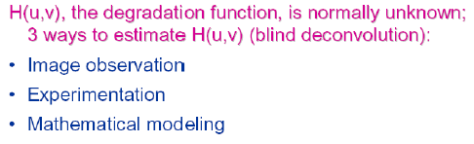
Degradation Estimation

Slide 4
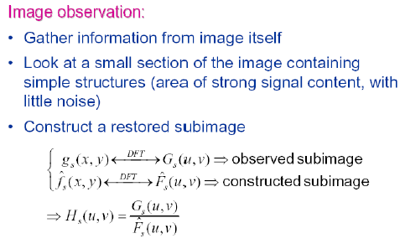
Degradation Estimation

Slide 5
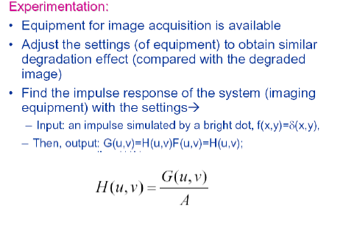
Degradation Estimation

Slide 6
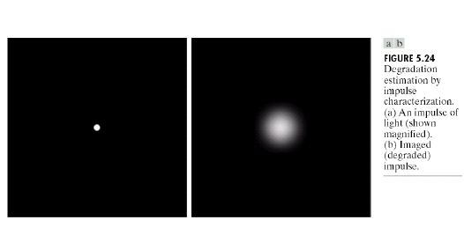
Degradation Estimation

Slide 7
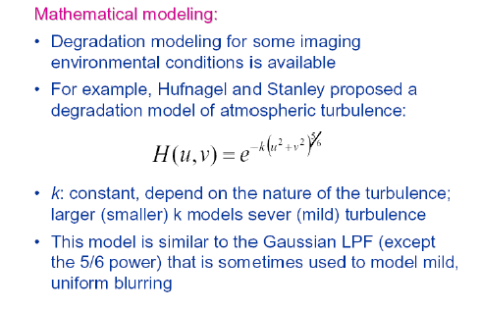
Degradation Estimation

Slide 8
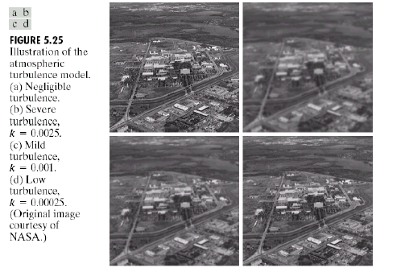
Mathematical Modeling Example

Slide 9
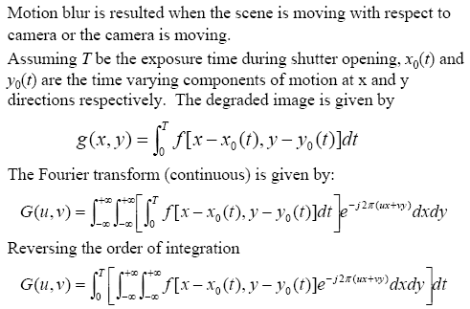
Motion Blur Modeling

Slide 10
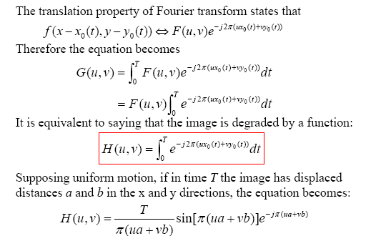
Motion Blur Modeling

Slide 11
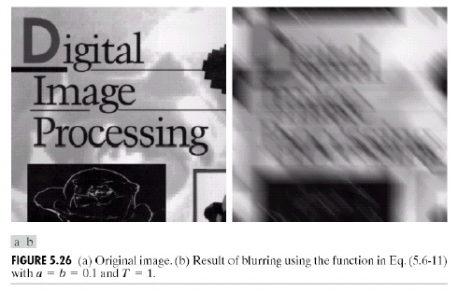
Motion Blur Modeling (example)

Slide 12
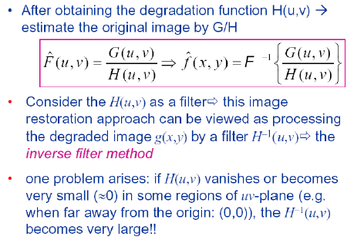
Inverse Filtering

Slide 13
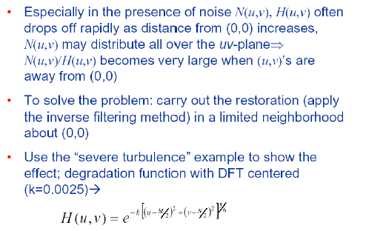
Inverse Filtering

Slide 14
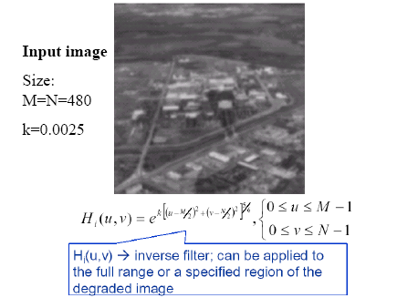
Example: Inverse Filtering

Slide 15
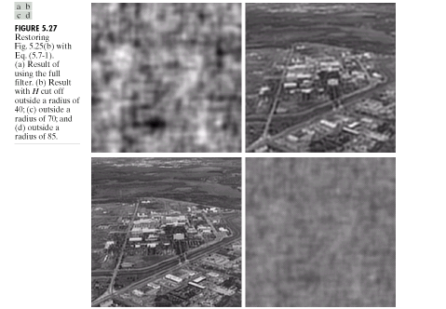
Example: Inverse Filtering

Slide 16
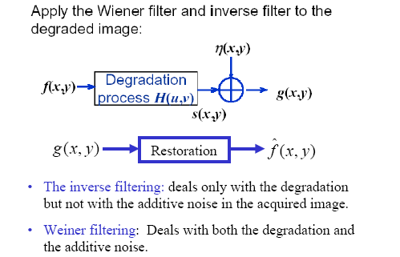
Minimum Mean Square Error (Weiner) Filtering

Slide 17
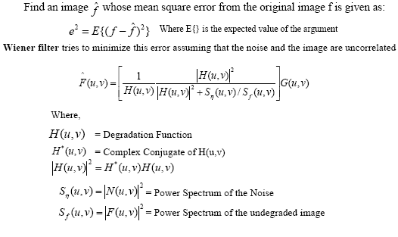
Minimum Mean Square Error (Weiner) Filtering

Slide 18
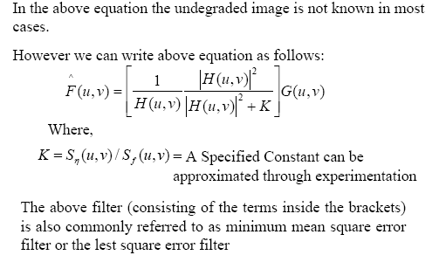
Minimum Mean Square Error (Weiner) Filtering

Slide 19
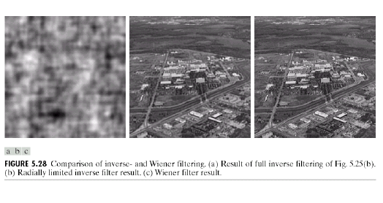
Example 1: Weiner Filtering

Slide 20
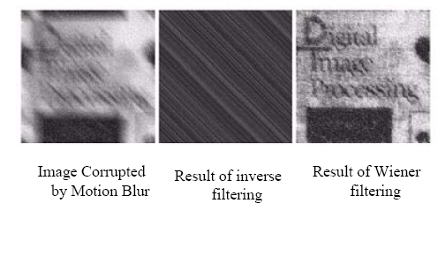
Example 2: Weiner Filtering

Slide 21
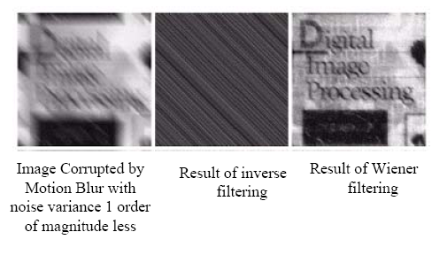
Example 2: Weiner Filtering

Slide 22
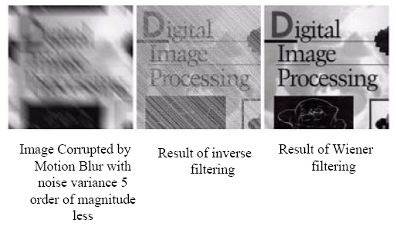
Example 2: Weiner Filtering

Slide 23
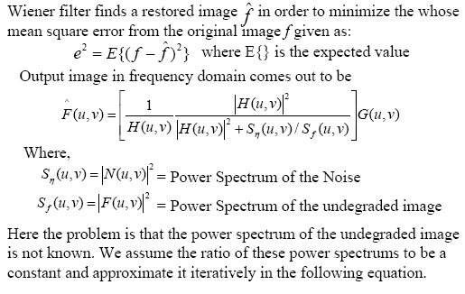
Wiener Filtering

Slide 24
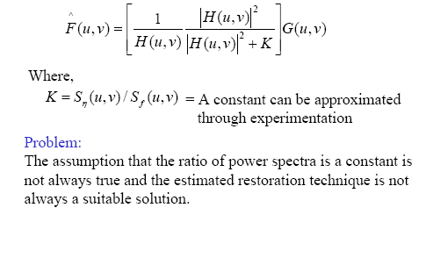
Wiener Filtering (Continued)

Slide 25
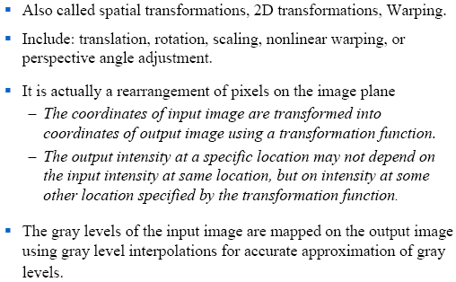
Geometric Transformations

Slide 26
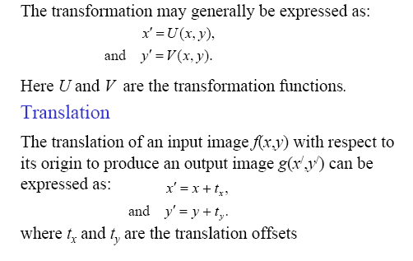
Some Basic Geometric Transformations

Slide 27
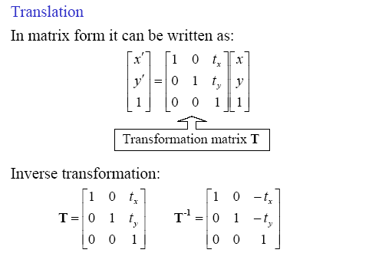
Some Basic Geometric Transformations

Slide 28
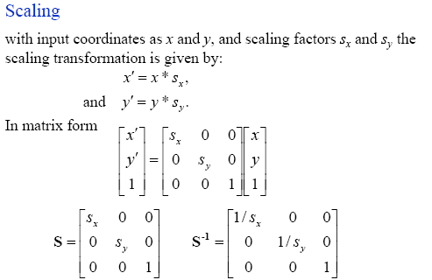
Some Basic Geometric Transformations

Slide 29
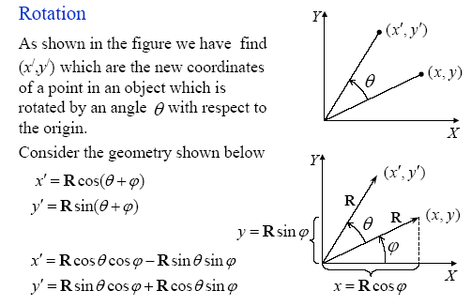
Some Basic Geometric Transformations

Slide 30
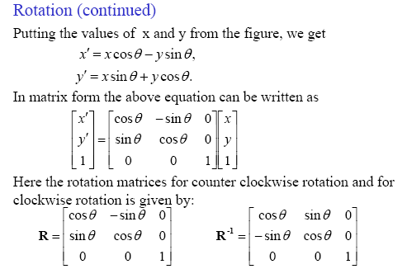
Some Basic Geometric Transformations

Slide 31
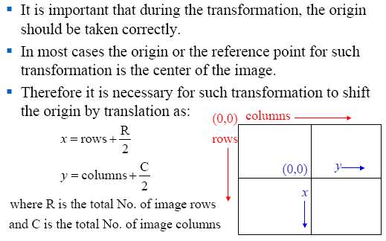
Origin Translation

Slide 32
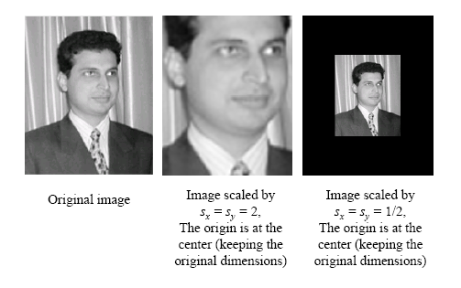
Scaling (Example)

Slide 33
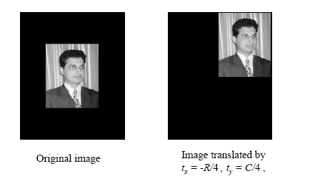
Translation (Example)

Slide 34
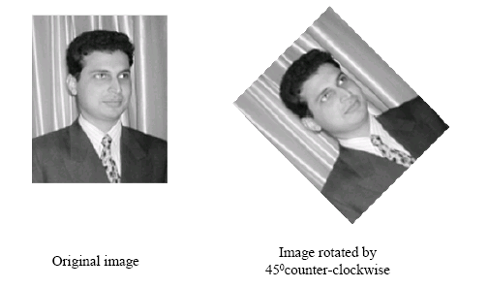
Rotation (Example)

Slide 35
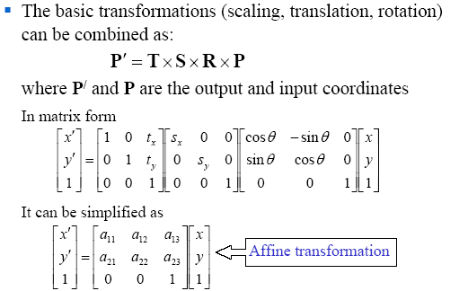
Combination of Transformations

Slide 36
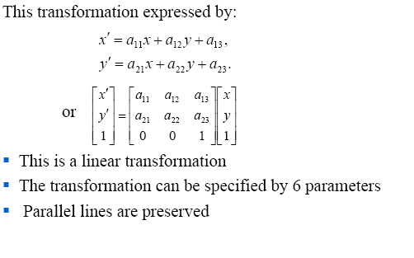
Affine Transformation

Slide 37
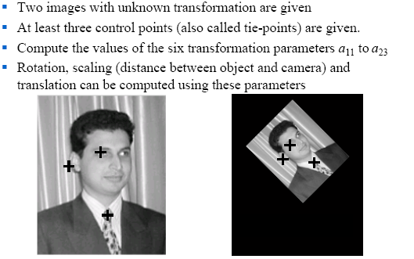
Basic Measurements Using Images

